Slide 1
REVELATION
THE BOOK OF

Slide 2


Slide 3
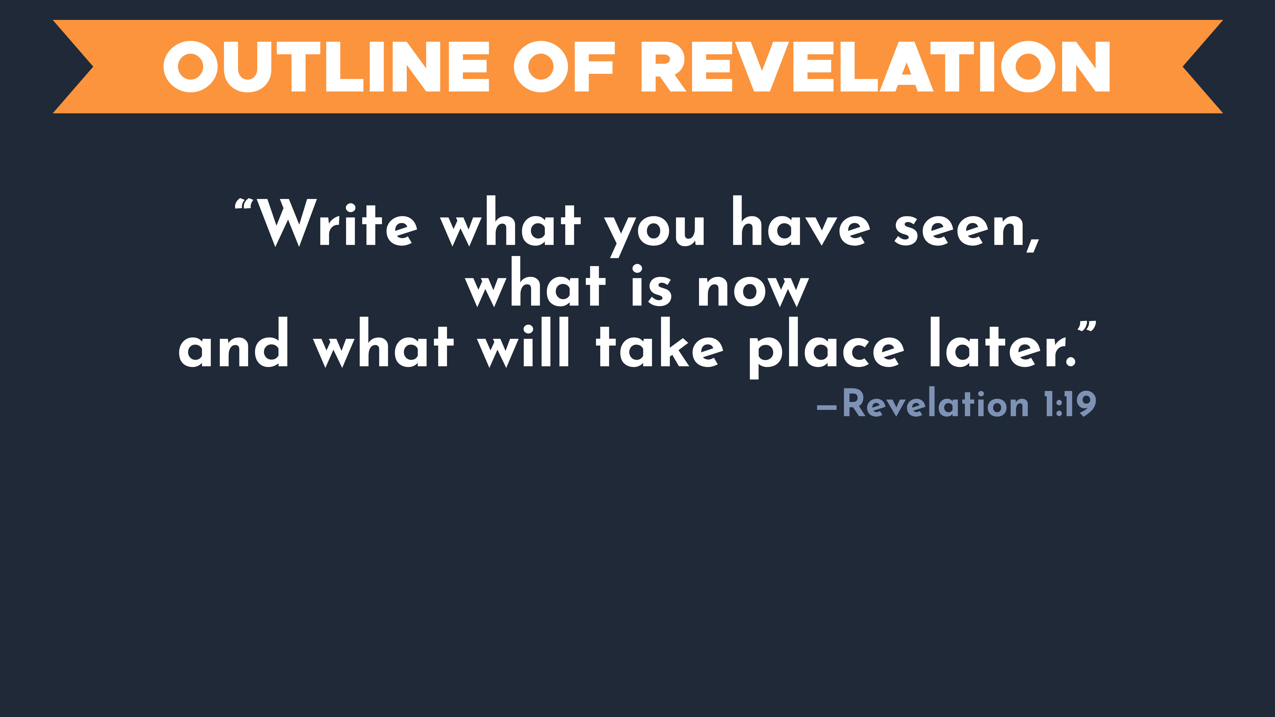

Slide 4
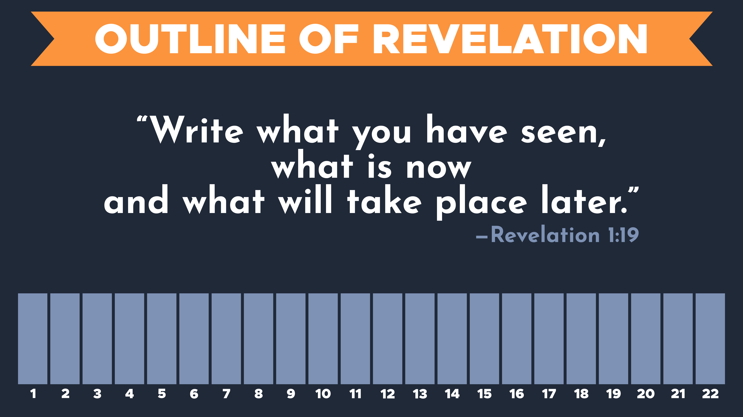

Slide 5
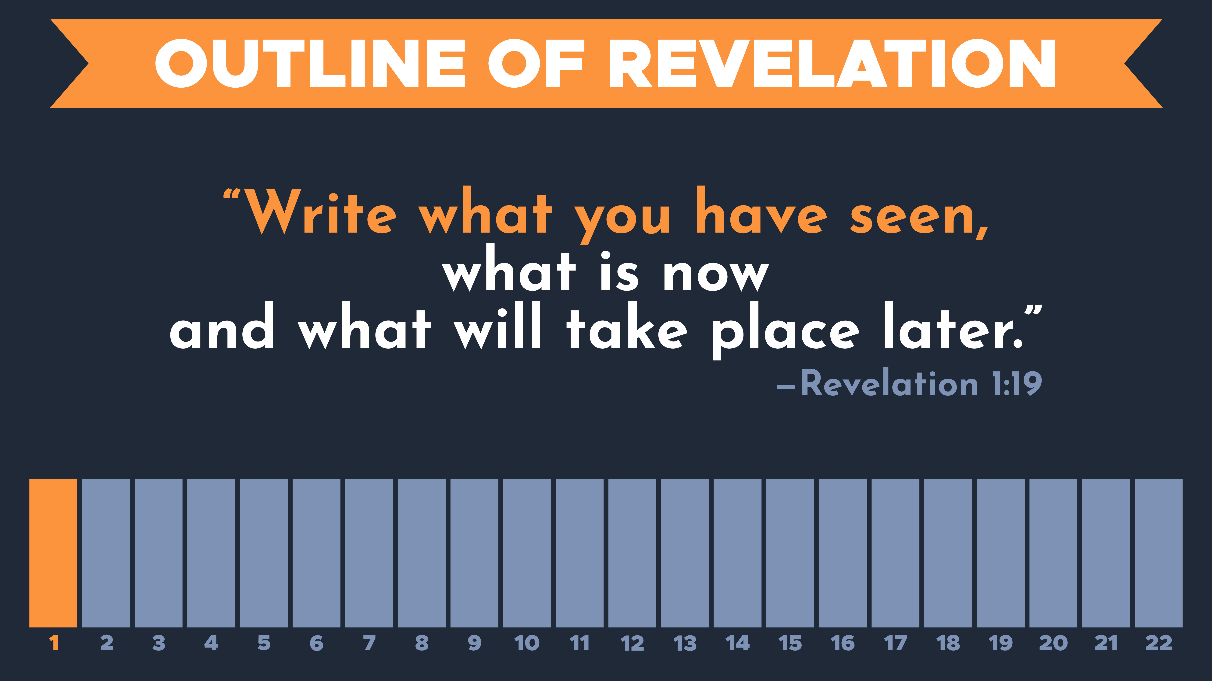

Slide 6
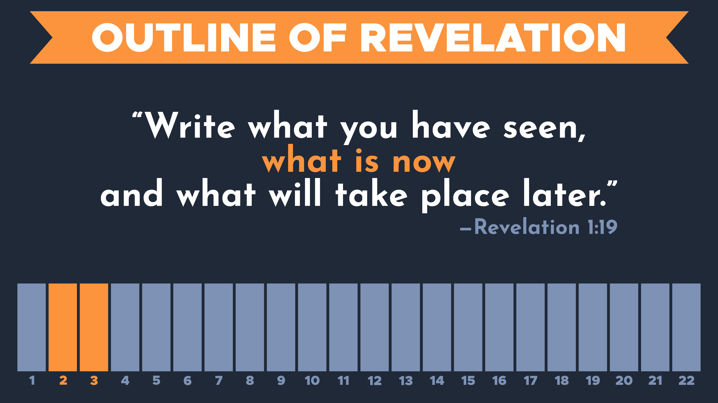

Slide 7
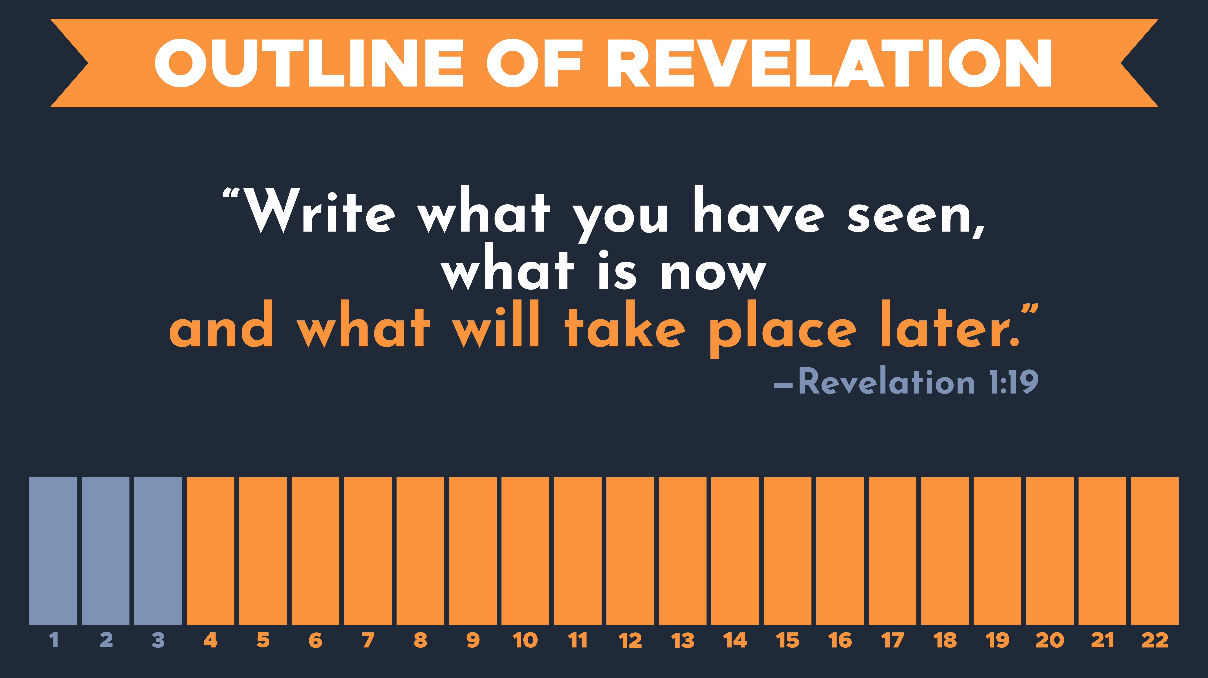

Slide 9
Revelation 2
¹ “To the angel of the church in Ephesus write:

Slide 10
Revelation 2
¹ “To the angel of the church in Ephesus write:
      Ephesus
      It was an important seaport in the ancient world.
      A prominent city during the Roman Empire and was a center of commerce.
      A cultural hub and center for learning.
      Was most known as a religious center.

Slide 11
Revelation 2
¹ “To the angel of the church in Ephesus write:
      Ephesus
      Many leading figures in the New Testament church led in this city.
        The Apostle Paul started this church in the mid-50s AD.
        Paul’s protégé, Timothy led the church in this city
        The Apostle John led in Ephesus upon his return from exile on the Island of Patmos.

Slide 12
Revelation 2
¹ “To the angel of the church in Ephesus write:
      Ephesus
      Many leading figures in the New Testament church led in this city.
      It was probably the largest and most influential church in the region.

Slide 13
Revelation 2
¹ “To the angel of the church in Ephesus write:
These are the words of him who holds the seven stars in his right hand and walks among the seven golden lampstands.

Slide 14
Revelation 2
¹ “To the angel of the church in Ephesus write:
These are the words of him who holds the seven stars in his right hand and walks among the seven golden lampstands. ² I know your deeds, your hard work and your perseverance. I know that you cannot tolerate wicked people, that you have tested those who claim to be apostles but are not, and have found them false.

Slide 15
Revelation 2
¹ “To the angel of the church in Ephesus write:
These are the words of him who holds the seven stars in his right hand and walks among the seven golden lampstands. ² I know your deeds, your hard work and your perseverance. I know that you cannot tolerate wicked people, that you have tested those who claim to be apostles but are not, and have found them false.

Slide 16
Revelation 2
      Many in our culture view Christians as intolerant.
      Working out with a buddy from work who is in the Diversity, Equity and Inclusion (DE&I) department
        and discovering he has a swastika tattoo.
¹ “To the angel of the church in Ephesus write:
These are the words of him who holds the seven stars in his right hand and walks among the seven golden lampstands. ² I know your deeds, your hard work and your perseverance. I know that you cannot tolerate wicked people, that you have tested those who claim to be apostles but are not, and have found them false.

Slide 17
Revelation 2
¹ “To the angel of the church in Ephesus write:
These are the words of him who holds the seven stars in his right hand and walks among the seven golden lampstands. ² I know your deeds, your hard work and your perseverance. I know that you cannot tolerate wicked people, that you have tested those who claim to be apostles but are not, and have found them false.
      Many in our culture view Christians as intolerant.
      Sitting in a vegan Zoom class
        and someone pulls out a 10oz ribeye and starts eating it.

Slide 18
Revelation 2
¹ “To the angel of the church in Ephesus write:
These are the words of him who holds the seven stars in his right hand and walks among the seven golden lampstands. ² I know your deeds, your hard work and your perseverance. I know that you cannot tolerate wicked people, that you have tested those who claim to be apostles but are not, and have found them false.
      Many in our culture view Christians as intolerant.
      Getting caught by someone in your environmentalist group
      snapping a thermometer and emptying the mercury in the Olentangy River.

Slide 19
Revelation 2
¹ “To the angel of the church in Ephesus write:
These are the words of him who holds the seven stars in his right hand and walks among the seven golden lampstands. ² I know your deeds, your hard work and your perseverance. I know that you cannot tolerate wicked people, that you have tested those who claim to be apostles but are not, and have found them false.
      When Jesus refers to “wicked men,” he’s talking about someone who claims to be from God but were not.

Slide 20
Revelation 2
³ You have persevered and have endured hardships for my name, and have not grown weary.
      Ephesus was a hostile place to live for followers of Jesus.
      Emperor Domitian was worshipped as a god.
      Therefore, the Ephesians saw their fair share of persecution: seizure of property, discrimination, being ostracized.
      Can you imagine getting a letter like this from Jesus?

Slide 21
Revelation 2
³ You have persevered and have endured hardships for my name, and have not grown weary.
⁴ Yet I hold this against you: You have forsaken your first love. ⁵ Remember how far you have fallen! Repent and return to the things you did at first. If you do not repent, I will come to you and remove your lampstand from its place.

Slide 22
Revelation 2
³ You have persevered and have endured hardships for my name, and have not grown weary.
⁴ Yet I hold this against you: You have forsaken your first love. ⁵ Remember how far you have fallen! Repent and return to the things you did at first. If you do not repent, I will come to you and remove your lampstand from its place.
      Was it the feeling of excitement they had when they first started following Jesus?

Slide 23
Revelation 2
³ You have persevered and have endured hardships for my name, and have not grown weary.
⁴ Yet I hold this against you: You have forsaken your first love. ⁵ Remember how far you have fallen! Repent and return to the things you did at first. If you do not repent, I will come to you and remove your lampstand from its place. ⁶ But you have this in your favor: You hate the practices of the Nicolaitans, which I also hate.
      Was it the feeling of excitement they had when they first started following Jesus?
      Or was it the love they once had for others?
        Ephesians 4:15: “Speaking the truth in love we will in all aspects grow up to be like Christ.”

Slide 24
Revelation 2
³ You have persevered and have endured hardships for my name, and have not grown weary.
⁴ Yet I hold this against you: You have forsaken your first love. ⁵ Remember how far you have fallen! Repent and return the things you did at first. If you do not repent, I will come to you and remove your lampstand from its place. ⁶ But you have this in your favor: You hate the practices of the Nicolaitans, which I also hate.
      One of the best ways to gauge your love for God is to look at how you treat others.
        Matthew 22:36-40: “Teacher, which is the greatest commandment in the Law?” Jesus replied: “ ‘Love the Lord your God with all your heart and with all your soul and with all your mind.’ This is the first and greatest commandment. And the second is like it: ‘Love your neighbor as yourself.’ All the Law and the Prophets hang on these two commandments.”
      Was it the feeling of excitement they had when they first started following Jesus?
      Or was it the love they once had for others?
        Ephesians 4:15: “Speaking the truth in love we will in all aspects grow up to be like Christ.”

Slide 25
Revelation 2
³ You have persevered and have endured hardships for my name, and have not grown weary.
⁴ Yet I hold this against you: You have forsaken your first love. ⁵ Remember how far you have fallen! Repent and return the things you did at first. If you do not repent, I will come to you and remove your lampstand from its place. ⁶ But you have this in your favor: You hate the practices of the Nicolaitans, which I also hate.
      One of the best ways to gauge your love for God is to look at how you treat others.
        1 John 3:20-21: “Whoever claims to love God yet hates a brother or sister is a liar. For whoever does not love their brother and sister, whom they have seen, cannot love God, whom they have not seen. And he has given us this command: Anyone who loves God must also love their brother and sister.”
      Was it the feeling of excitement they had when they first started following Jesus?
      Or was it the love they once had for others?
        Ephesians 4:15: “Speaking the truth in love we will in all aspects grow up to be like Christ.”

Slide 26
Revelation 2
³ You have persevered and have endured hardships for my name, and have not grown weary.
⁴ Yet I hold this against you: You have forsaken the love you had at first. ⁵ Consider how far you have fallen! Repent and do the things you did at first. If you do not repent, I will come to you and remove your lampstand from its place. ⁶ But you have this in your favor: You hate the practices of the Nicolaitans, which I also hate.
      One of the best ways to gauge your love for God is to look at how you treat others.
        Matthew 25:35-40: “For I was hungry, and you fed me. I was thirsty, and you gave me a drink. I was a stranger, and you invited me into your home. His followers will ask him, ‘Lord, when did we see you hungry, or thirsty and when did we see you as a stranger and invite you in? Jesus said, ‘I tell you, whatever you did for one of the least of these brothers and sisters of mine, you did for me.’”
      Was it the feeling of excitement they had when they first started following Jesus?
      Or was it the love they once had for others?
        Ephesians 4:15: “Speaking the truth in love we will in all aspects grow up to be like Christ.”

Slide 27
Revelation 2
³ You have persevered and have endured hardships for my name, and have not grown weary.
⁴ Yet I hold this against you: You have forsaken the love you had at first. ⁵ Consider how far you have fallen! Repent and do the things you did at first. If you do not repent, I will come to you and remove your lampstand from its place. ⁶ But you have this in your favor: You hate the practices of the Nicolaitans, which I also hate.
      One of the best ways to gauge your love for God is to look at how you treat others.
        John 13:34; 14:15: I am giving you a new commandment: Love each other. Just as I have loved you…If you love me, then obey my commandments.
      Was it the feeling of excitement they had when they first started following Jesus?
      Or was it the love they once had for others?
        Ephesians 4:15: “Speaking the truth in love we will in all aspects grow up to be like Christ.”

Slide 28
Revelation 2
³ You have persevered and have endured hardships for my name, and have not grown weary.
⁴ Yet I hold this against you: You have forsaken the love you had at first. ⁵ Consider how far you have fallen! Repent and do the things you did at first. If you do not repent, I will come to you and remove your lampstand from its place. ⁶ But you have this in your favor: You hate the practices of the Nicolaitans, which I also hate.
      One of the best ways to gauge your love for God is to look at how you treat others.
      When we say “love,” we’re not talking about being a nice person, or having a strong feeling of affection toward someone.
        1 John 3:16: “This is how we know what love is: Jesus Christ laid down his life for us. And we ought to lay down our lives for our brothers.” .
      Was it the feeling of excitement they had when they first started following Jesus?
      Or was it the love they once had for others?
        Ephesians 4:15: “Speaking the truth in love we will in all aspects grow up to be like Christ.”

Slide 29
Revelation 2
³ You have persevered and have endured hardships for my name, and have not grown weary.
⁴ Yet I hold this against you: You have forsaken the love you had at first. ⁵ Consider how far you have fallen! Repent and do the things you did at first. If you do not repent, I will come to you and remove your lampstand from its place. ⁶ But you have this in your favor: You hate the practices of the Nicolaitans, which I also hate.
      Signs that you have the “Ephesian syndrome.”
      Your gatherings feel more like a workplace than a family gathering.
      You are busy doing things for God, but much of it is not related to loving people.
      Guests no longer comment on how “close knit” people seem in your group.
      Was it the feeling of excitement they had when they first started following Jesus?
      Or was it the love they once had for others?
        Ephesians 4:15: “Speaking the truth in love we will in all aspects grow up to be like Christ.”

Slide 30
Revelation 2
³ You have persevered and have endured hardships for my name, and have not grown weary.
⁴ Yet I hold this against you: You have forsaken your first love. ⁵ Remember from where you have fallen! Repent and return to the things you did at first. If you do not repent, I will come to you and remove your lampstand from its place.

Slide 31
Revelation 2
³ You have persevered and have endured hardships for my name, and have not grown weary.
⁴ Yet I hold this against you: You have forsaken your first love. ⁵ Remember from where you have fallen! Repent and return to the things you did at first. If you do not repent, I will come to you and remove your lampstand from its place.
      In other love for others
      “I used to be excited about my building closeness with my Christian friends...”
      “But now they just irritate me.”
      “I used to take an interest in my Christian roommates’ lives...”
        “But now it feels like we’re like strangers passing in the hallway”

Slide 32
Revelation 2
³ You have persevered and have endured hardships for my name, and have not grown weary.
⁴ Yet I hold this against you: You have forsaken the love you had at first. ⁵ Remember from where you have fallen! Repent and do the things you did at first. If you do not repent, I will come to you and remove your lampstand from its place. ⁶ But you have this in your favor: You hate the practices of the Nicolaitans, which I also hate.
      In other love for others
      “I used to think about and pray for people in my group...”
        “But now my mind is preoccupied with things I need to do and stuff I need to accomplish.”
      “I used to enjoy hanging out with people after meetings and getting to know them...
        “But now I don’t see the point; it’s just the same old people there.”

Slide 33
Revelation 2
³ You have persevered and have endured hardships for my name, and have not grown weary.
⁴ Yet I hold this against you: You have forsaken the love you had at first. ⁵ Remember from where you have fallen! Repent and do the things you did at first. If you do not repent, I will come to you and remove your lampstand from its place. ⁶ But you have this in your favor: You hate the practices of the Nicolaitans, which I also hate.
      In our love for God
      “I used to share what was on my mind with God in prayer...”
      “But now I feel like prayer is a functional thing I have to check off my list.”
      “I use feel energized serving God and accomplishing his purposes…”
      “But now I feel more excited about my career, hobbies, and purchases.”

Slide 34
Revelation 2
³ You have persevered and have endured hardships for my name, and have not grown weary.
⁴ Yet I hold this against you: You have forsaken the love you had at first. ⁵ Remember from where you have fallen! Repent and do the things you did at first. If you do not repent, I will come to you and remove your lampstand from its place. ⁶ But you have this in your favor: You hate the practices of the Nicolaitans, which I also hate.
      In our love for God
      “I used to spend time with God every day...”
      “But now I don’t seem to find for it.”

Slide 35
Revelation 2
³ You have persevered and have endured hardships for my name, and have not grown weary.
⁴ Yet I hold this against you: You have forsaken your first love. ⁵ Remember from where you have fallen! Repent and return to the things you did at first. If you do not repent, I will come to you and remove your lampstand from its place.

Slide 36
Revelation 2
³ You have persevered and have endured hardships for my name, and have not grown weary.
⁴ Yet I hold this against you: You have forsaken your first love. ⁵ Remember from where you have fallen! Repent and return to the things you did at first. If you do not repent, I will come to you and remove your lampstand from its place.

Slide 37
Revelation 2
³ You have persevered and have endured hardships for my name, and have not grown weary.
⁴ Yet I hold this against you: You have forsaken your first love. ⁵ Remember from where you have fallen! Repent and return to the things you did at first. If you do not repent, I will come to you and remove your lampstand from its place.
      Revelation 1:20: “...the seven lampstands are the seven churches.”

Slide 38
Revelation 2
⁷ Whoever has ears, let them hear what the Spirit says to the churches. To the one who is victorious, I will give the right to eat from the tree of life, which is in the paradise of God.

Slide 39
Revelation 2
⁷ Whoever has ears, let them hear what the Spirit says to the churches. To the one who is victorious, I will give the right to eat from the tree of life, which is in the paradise of God.

Slide 40
Revelation 2
⁷ Whoever has ears, let them hear what the Spirit says to the churches. To the one who is victorious, I will give the right to eat from the tree of life, which is in the paradise of God.

Slide 41
Revelation 2
⁷ Whoever has ears, let them hear what the Spirit says to the churches. To the one who is victorious, I will give the right to eat from the tree of life, which is in the paradise of God.

Slide 42
What should be the primary quality of someone who follows Jesus?
  Someone who is super knowledgeable?
  Someone who is dedicated?
  Someone who is morally superior to those around them?
  Someone who holds conservative values?

Slide 43
What should be the primary quality of someone who follows Jesus?
  Someone who is super knowledgeable?
  Someone who is dedicated?
  Someone who is morally superior to those around them?
  Someone who holds conservative values?
  The preeminent quality of a follower of Jesus should be love.

Slide 44
Application
  It’s never too late if you’ve lost your first love.
  If you want to grow in your love for others, start by experiencing God’s love.

Slide 45
REVELATION
THE BOOK OF

