Slide 1
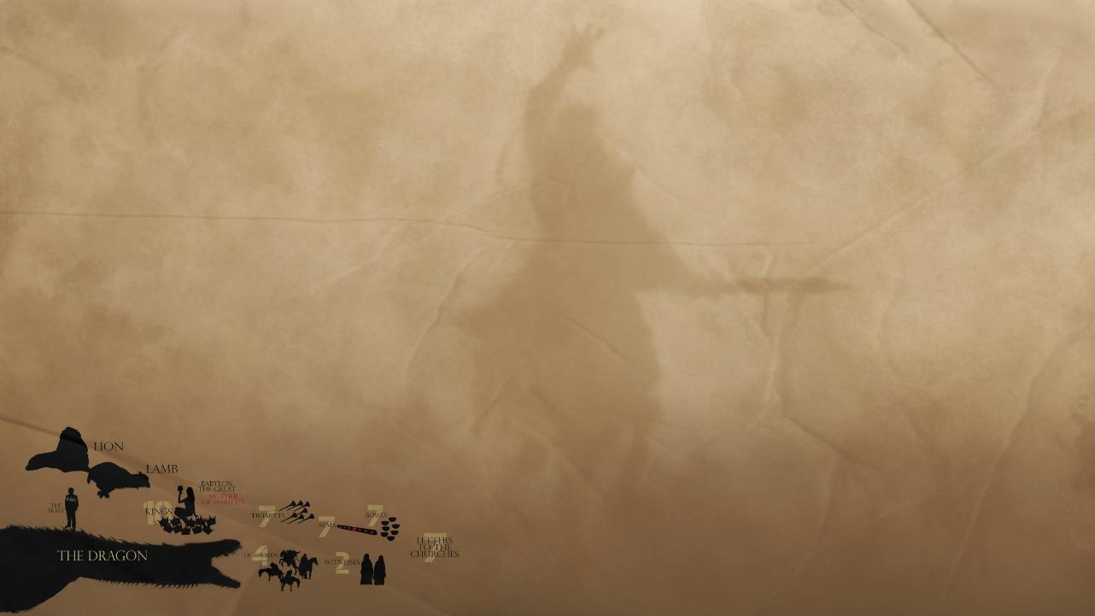

Slide 2


Slide 3
(Rev. 13:1) The dragon (Satan) stood on the shore of the sea.
And I saw a beast coming out of the sea.
It had ten horns and seven heads, with ten crowns on its horns, and on each head a blasphemous name.
World empires
(or kingdoms)
Psalm 30:7; Zechariah 4:7; Jeremiah 51:25; Daniel 2:35
This describes the Revived Roman Empire
(Rev. 17:9) Here is the mind which has wisdom.
The seven heads are seven mountains.
¹⁰ They are seven kings.

Slide 4
(Rev. 13:1) The dragon (Satan) stood on the shore of the sea.
And I saw a beast coming out of the sea.
It had ten horns and seven heads, with ten crowns on its horns, and on each head a blasphemous name.
World empires
(or kingdoms)
Psalm 30:7; Zechariah 4:7; Jeremiah 51:25; Daniel 2:35
#1. Egypt
#2. Assyria
#3. Babylon
#4. Media-Persia
#5. Greece
This describes the Revived Roman Empire
(Rev. 17:9) Here is the mind which has wisdom.
The seven heads are seven mountains.
¹⁰ They are seven kings.
Five have fallen, one is, the other has not yet come.
When he comes, he must remain a little while.
#7. Revived Roman Empire
#6. Ancient Roman Empire

Slide 5
(Rev. 13:1) The dragon (Satan) stood on the shore of the sea.
And I saw a beast coming out of the sea.
It had ten horns and seven heads, with ten crowns on its horns, and on each head a blasphemous name.
This describes the Revived Roman Empire
(Rev. 17:11) The beast which was and is not,
is himself also an eighth
and is one of the seven.
He goes to destruction.

Slide 6
(Rev. 13:1) The dragon (Satan) stood on the shore of the sea.
And I saw a beast coming out of the sea.
It had ten horns and seven heads, with ten crowns on its horns, and on each head a blasphemous name.
This describes the Revived Roman Empire
(Rev. 17:12) The ten horns you saw are ten kings.

Slide 7
(Rev. 13:1) The dragon (Satan) stood on the shore of the sea.
And I saw a beast coming out of the sea.
It had ten horns and seven heads, with ten crowns on its horns, and on each head a blasphemous name.
This describes the Revived Roman Empire
(Rev. 17:12) The ten horns you saw are ten kings.
These kings have not yet received a kingdom.
They receive authority as kings with the beast for one hour.

Slide 8
(Rev. 13:2) The beast I saw resembled a leopard, but had feet like those of a bear and a mouth like that of a lion.
The dragon (Satan) gave the beast his power and his throne and great authority.

Slide 9

(Dan. 7:3) Four great beasts, each different from the others, came up out of the sea.
“Wait! Why are we turning to all of these passages to interpret Revelation 13??”
Correlation shows that we’re getting the right interpretation.
e.g. Nicolaus Copernicus (astronomy) and Isaac Newton (physics).

Slide 10


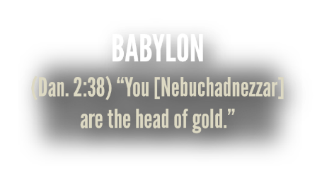
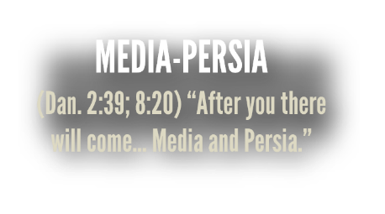

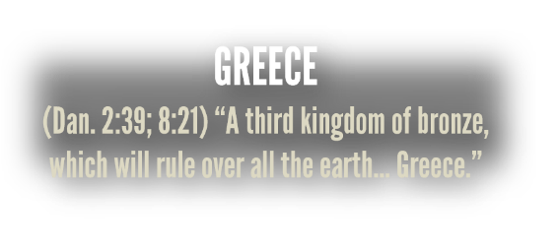
(Dan. 7:4) The first was like a lion,
and it had the wings of an eagle…
⁵ The second beast looked like a bear.
It had three ribs in its mouth…
⁶ One looked like a leopard
with four wings and four heads.
Virtually all scholars agree that the visions in Daniel represent “empires or kingdoms.”
Stephen R. Miller, Daniel. New American Commentary. Vol. 18. (Nashville, TN: Broadman, 1994), 92-93, 218.

Slide 11

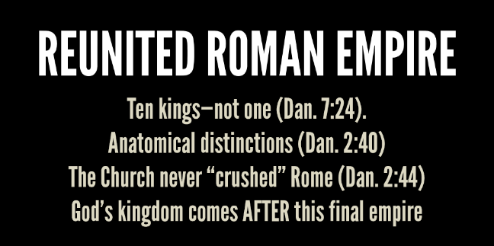
(Dan. 7:7) There was a fourth beast:
terrifying and frightening and very powerful…
It was different from all the former beasts, and it had ten horns.

Slide 12

(Dan. 7:8) While I was thinking about the horns, there was another horn.
It was a little one, and it came up among the other horns.
Three of the first horns were uprooted before it.
This horn had eyes like
the eyes of a human being and a mouth that spoke boastfully.
(Dan. 7:23) The fourth beast is a fourth kingdom that will appear on earth.
It will be different from all the other kingdoms and will devour the whole earth, trampling it down and crushing it.

Slide 13
(Dan. 7:8) While I was thinking about the horns, there was another horn.
It was a little one, and it came up among the other horns.
Three of the first horns were uprooted before it.
This horn had eyes like
the eyes of a human being and a mouth that spoke boastfully.
(Dan. 7:24) The ten horns are ten kings who will come from this kingdom.
After them another king will arise, different from the earlier ones. He will subdue three kings.

Slide 14
(Dan. 7:8) While I was thinking about the horns, there was another horn.
It was a little one, and it came up among the other horns.
Three of the first horns were uprooted before it.
This horn had eyes like
the eyes of a human being and a mouth that spoke boastfully.
(Dan. 9:27) Half of seven years.
(Dan. 7:25) Time, times and half a time.
(Dan. 12:7) Time, times and half a time.
(Rev. 11:2) 42 months.
(Rev. 11:3) 1,260 days.
(Rev. 12:14) Time, times and half a time.
(Rev. 13:5) 42 months.
(Dan. 7:25) He will speak against the Most High and oppress his holy people and try to change the set times and the laws.
The holy people will be delivered into his hands for a time, times and half a time.

Slide 15

Called the “beast.”
13:1-2; Rev. 17:3
Persecutes believers.
Revelation 13:7
Destroyed by Christ.
Revelation 19:19-20; 2 Thessalonians 2:8
Arises from 10 kingdoms.
Revelation 17:12
Reigns for 3.5 years.
Revelation 12:6, 14; 13:5
Blasphemes God and people.
Revelation 13:5; 2 Thessalonians 2:4
Called the “beast.”
Daniel 7:7, 11, 19, 23
Persecutes believers.
Daniel 7:25
Destroyed by Christ.
Daniel 7:26-27
Arises from 10 kingdoms.
Daniel 7:8, 20, 24
Reigns for 3.5 years.
Daniel 7:25
Blasphemes God and people.
Daniel 7:8

Slide 16









(Rev. 13:2) The beast I saw resembled a leopard, but had feet like those of a bear and a mouth like that of a lion.
The dragon (Satan) gave the beast his power and his throne and great authority.

Slide 17
(Rev. 13:3) One of the heads of the beast seemed to have had a fatal wound, but the fatal wound had been healed.
The whole world was filled with wonder and followed the beast.
“Fatal wound” (sphazō)
#1. Is the Beast killed and resurrected?
Jesus was also “slain” (sphazō, Revelation 5:6; 13:3)
Jesus also “lived” (ezēsen, Revelation 2:8; 13:14)
“The false prophet makes the earth… worship the first beast, whose fatal wound was healed” (Rev. 13:12).
“The beast who had the wound of the sword and has come to life” (Rev. 13:14).
Robert L. Thomas, Revelation 8-22 (Chicago: Moody Publishers, 1995), 159.
#2. Does this refer to the renewed Roman empire?
The “heads” refer to kings or kingdoms (v.2).
It’s questionable whether Satan cannot resurrect humans.
John F. Walvoord, The Revelation of Jesus Christ (2008), 199-200.

Slide 18
(Rev. 13:4) People worshiped the dragon because he had given authority to the beast, and they also worshiped the beast and asked,
“Who is like the beast? Who can wage war against it?”

Slide 19
(Rev. 13:5) The beast was given a mouth to utter proud words and blasphemies
and to exercise its authority for forty-two months.
Daniel 7:25

Slide 20
(Rev. 13:6) It opened its mouth to blaspheme God,
and to slander his name and his dwelling place
and those who live in heaven.
Daniel 7:8

Slide 21
(Rev. 13:7) It was given power to wage war against God’s holy people and to conquer them.
And it was given authority over every tribe, people, language and nation.
Daniel 7:25
Revelation 5:9

Slide 22
(Rev. 13:8) All who dwell on the earth will worship him,
everyone whose name has not been written from the foundation of the world in the book of life of the Lamb who has been slain.

Slide 23
(Rev. 13:8) All who dwell on the earth will worship him,
everyone whose name has not been written from the foundation of the world in the book of life of the Lamb who has been slain.

Slide 24
(Rev. 13:9) Whoever has ears, let them hear.
“He who has an ear, let him hear
what the Spirit says to the churches.”
Revelation 2-3

Slide 25
(Rev. 13:10) “If anyone is to go into captivity, into captivity they will go. If anyone is to be killed with the sword, with the sword they will be killed.”
This calls for patient endurance and faithfulness on the part of God’s people.

Slide 26
(Rev. 13:10) “If anyone is to go into captivity, into captivity they will go. If anyone is to be killed with the sword, with the sword they will be killed.”
This calls for patient endurance and faithfulness on the part of God’s people.

Slide 27

What do we know about him?
He will be a Gentile, not Jewish.
“No regard for the gods of his fathers” (Daniel 11:37).
He will be a powerful speaker.
He “will speak monstrous things against the God of gods” (Dan. 11:36; cf. Rev. 13:5).
He will bring (and break) world peace.
Daniel 9:27; 1 Thessalonians 5:2-3
He will claim to be God incarnate,
and he will stand in the rebuilt Temple of God.
2 Thess. 2:4; cf. Rev. 13:8; Mk. 13:14; Dan. 11:37

Slide 28
What do we know about him?
He will be a Gentile, not Jewish.
“No regard for the gods of his fathers” (Daniel 11:37).
He will be a powerful speaker.
He “will speak monstrous things against the God of gods” (Dan. 11:36; cf. Rev. 13:5).
He will bring (and break) world peace.
Daniel 9:27; 1 Thessalonians 5:2-3
He will claim to be God incarnate,
and he will stand in the rebuilt Temple of God.
2 Thess. 2:4; cf. Rev. 13:8; Mk. 13:14; Dan. 11:37
The man of lawlessness… opposes and exalts himself above every so-called god or object of worship.
He takes his seat in the temple of God,
and he will display himself as being God.
2 Thessalonians 2:3-4

Slide 29
Plausibility of the Biblical Data
Rules over a Reunited Roman Empire of 10 kingdoms.
Revelation 13:1-2
Daniel 7:23-25

Slide 30

History of the European Union
Treaty of Rome (1957)
Creation of the European Economic Community (EEC) and Euratom
Maastricht Treaty (1992)
Formally established the European Union, citizenship, and potential currency
Creation of the Euro (2002)
When the EU inaugurated the “euro” in 2002 “for the first time since the Roman era, much of Europe had a single currency.” John McCormick and Jonathan Olsen, The European Union: Politics and Policies. 5th ed. (Boulder, CO: Westview, 2014), 6

Slide 31
History of the European Union
Treaty of Rome (1957)
Creation of the European Economic Community (EEC) and Euratom
Maastricht Treaty (1992)
Formally established the European Union, citizenship, and potential currency
Creation of the Euro (2002)
When the EU inaugurated the “euro” in 2002 “for the first time since the Roman era, much of Europe had a single currency.” John McCormick and Jonathan Olsen, The European Union: Politics and Policies. 5th ed. (Boulder, CO: Westview, 2014), 6
“There is now virtually unlimited free movement of people, money, goods, and services among most of its member states.”
John McCormick and Jonathan Olsen, The European Union: Politics and Policies. 5th ed. (Boulder, CO: Westview, 2014), 82.

Slide 32
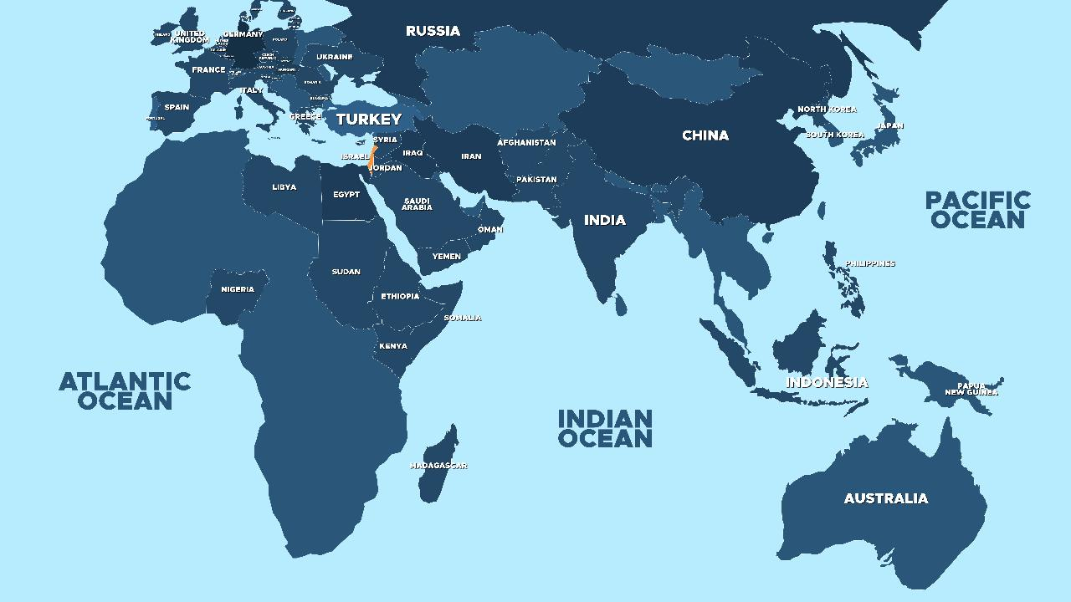

Slide 33
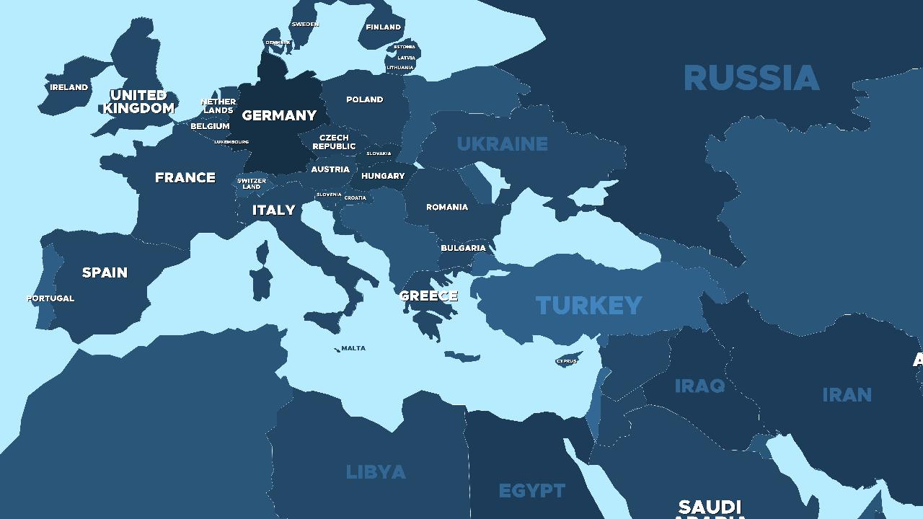

Slide 34
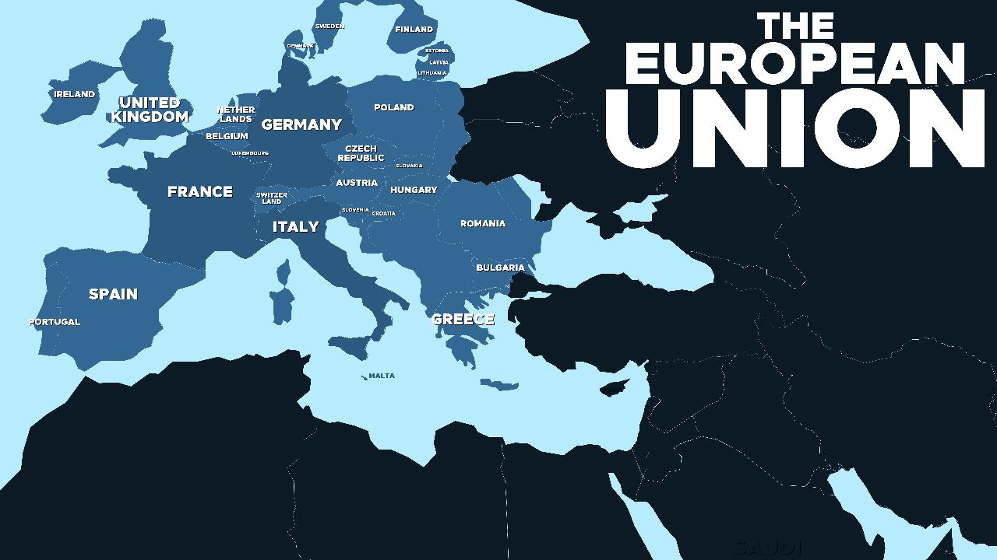

Slide 35
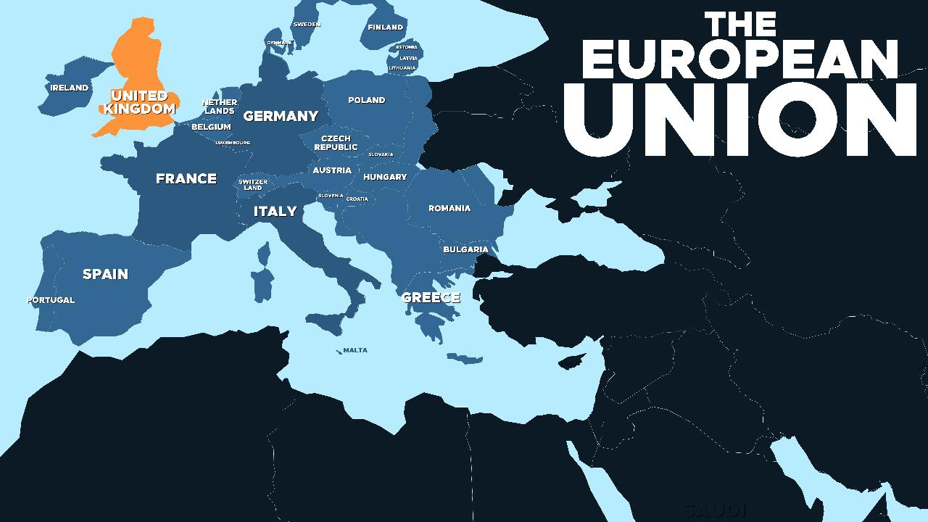
What about Brexit?

Slide 36

What about Brexit?

Slide 37
Plausibility of the Biblical Data
Rules over a Reunited Roman Empire of 10 kingdoms.
Revelation 13:1-2
Daniel 7:23-25

Slide 38
Plausibility of the Biblical Data
Rules over a Reunited Roman Empire of 10 kingdoms.
Revelation 13:1-2
Daniel 7:23-25
Creates a one-world government.
Revelation 13:4, 7-8

Slide 39


Slide 40

Global problems require
global solutions
Climate Change
María Fernanda Espinosa, “Transformative Shifts for a New Global Environmental Governance.”
Food shortages
Hilal Elver, “Global Food Systems in Crisis.”
Pandemics
Thidar Pyone and Soumya Swaminathan, “Global Health Governance: Lessons from the Pandemic.”
Imagine if a world leader claimed he could save us from famine, disease, and war?

Slide 41
Global problems require
global solutions
Climate Change
María Fernanda Espinosa, “Transformative Shifts for a New Global Environmental Governance.”
Food shortages
Hilal Elver, “Global Food Systems in Crisis.”
Pandemics
Thidar Pyone and Soumya Swaminathan, “Global Health Governance: Lessons from the Pandemic.”
Economic interdependence
Corporations want international trade.

Slide 42
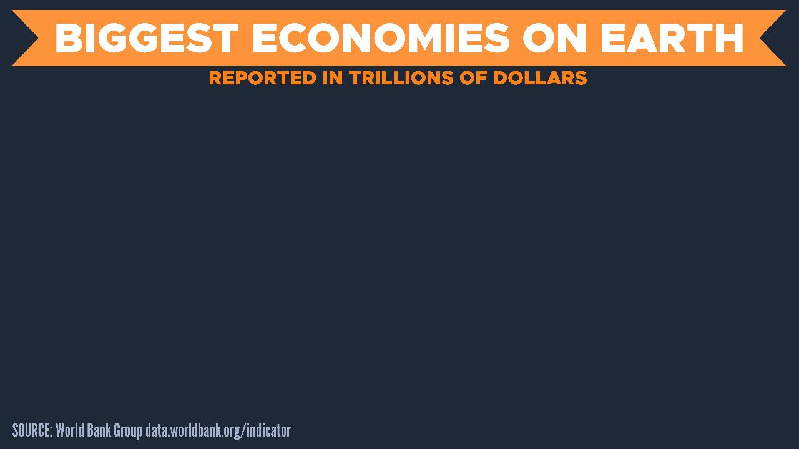

Slide 43
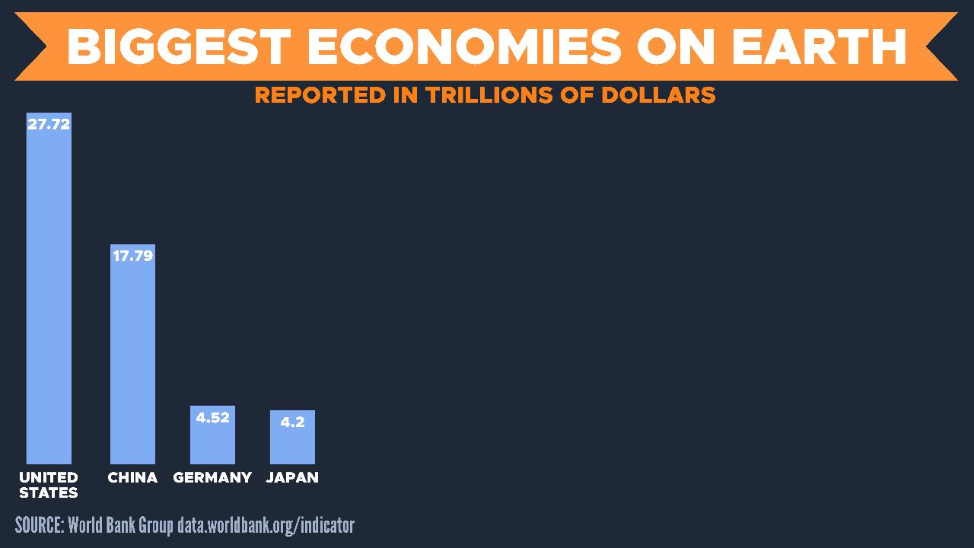

Slide 44
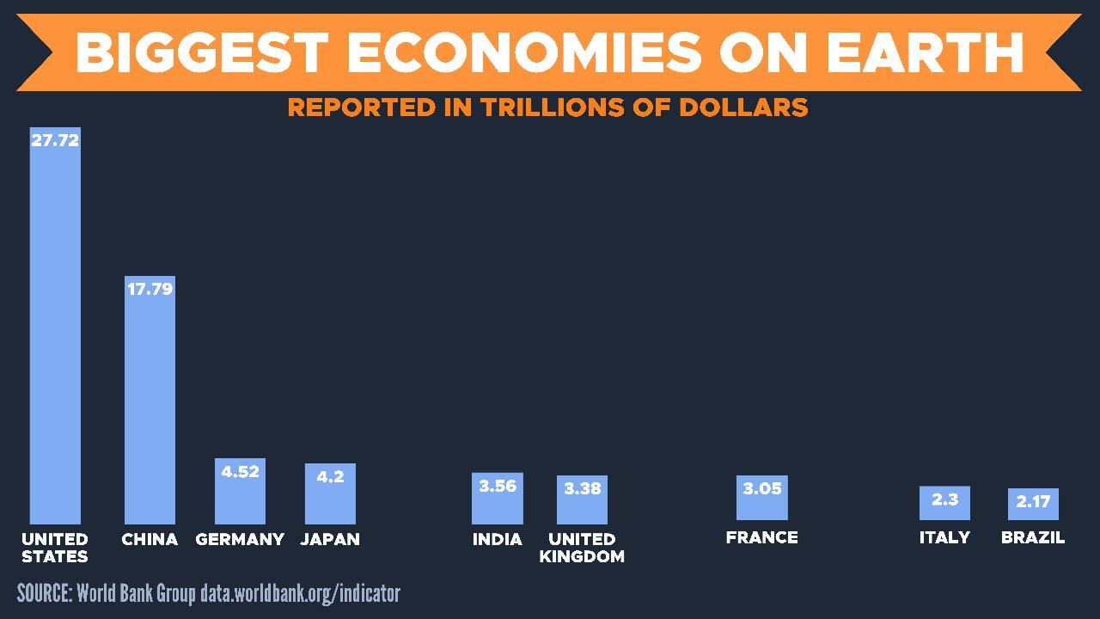

Slide 45
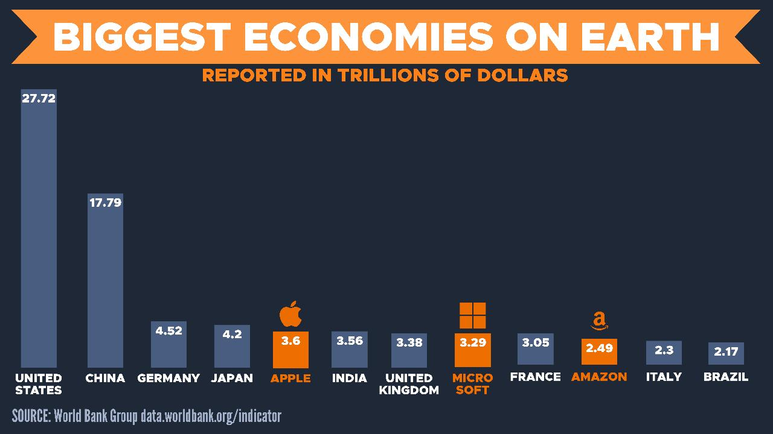
Current market cap

Slide 46
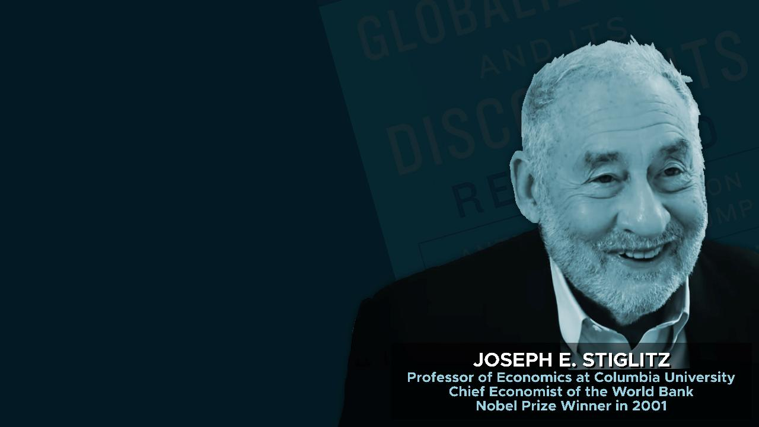
Global rules are needed…
We need rules and referees, to prevent countries from harming others, and to encourage countries to take actions that benefit others.
Joseph E. Stiglitz, Globalization and Its Discontents: Revisited (New York, NY: W. W. Norton & Company, 2018), 104-107.

Slide 47
Only through collective global action… can climate change be addressed.
If we don’t act in concert to contain highly contagious diseases, we risk facing global epidemics…
The private sector, on its own, won’t solve these problems.
Joseph E. Stiglitz, Globalization and Its Discontents: Revisited (New York, NY: W. W. Norton & Company, 2018), 104-107.

Slide 48
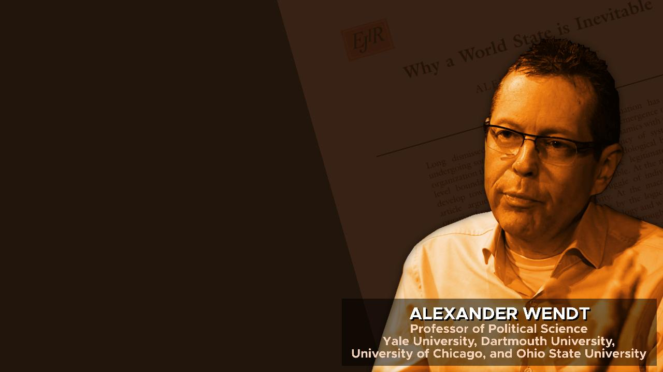
My guess is that a world state will emerge within 100 years.
It would not even require a world ‘government,’ if by this we mean a unitary actor with one person at the top whose individual decisions are final...
Alexander Wendt, “Why a World State is Inevitable.” European Journal of International Relations (December, 2003), 491-542.

Slide 49
The EU is already not far from meeting these requirements on a regional level.
Were a ‘completed’ EU-like structure to be globalized
it would be a world state.
Alexander Wendt, “Why a World State is Inevitable.” European Journal of International Relations (December, 2003), 491-542.

Slide 50
Plausibility of the Biblical Data
Rules over a Reunited Roman Empire of 10 kingdoms.
Revelation 13:1-2
Daniel 7:23-25
Creates a one-world government.
Revelation 13:4, 7-8

Slide 51
Plausibility of the Biblical Data
Rules over a Reunited Roman Empire of 10 kingdoms.
Revelation 13:1-2
Daniel 7:23-25
Creates a one-world government.
Revelation 13:4, 7-8
Will all people really worship one man as a god?
What is the “mark of the beast”?
Who does the “666” refer to?

Slide 52
Plausibility of the Biblical Data
Rules over a Reunited Roman Empire of 10 kingdoms.
Revelation 13:1-2
Daniel 7:23-25
Creates a one-world government.
Revelation 13:4, 7-8
More on this next week in Part Two…

Slide 53

Is suffering worth it?
“What blessings await you when people hate you and exclude you and mock you and curse you as evil because you follow the Son of Man. When that happens, be happy! Yes, leap for joy! For a great reward awaits you in heaven” (Luke 6:22-23).
Are you able to withstand this?
“Don’t be afraid, for I am with you. Don’t be discouraged, for I am your God. I will strengthen you and help you. I will hold you up with my right hand” (Isaiah 41:10).

Slide 54

